Slide 1
Arch Linux
Douglas Otstott
Contents
What is Arch?
Quick Install Guide
Pacman
Adding a GUI

Slide 2
Arch Linux
What is Arch?
  A Linux Distrubtion
What is a distrubtion?
  Arch is redefining the word ”Operating System”

Slide 3
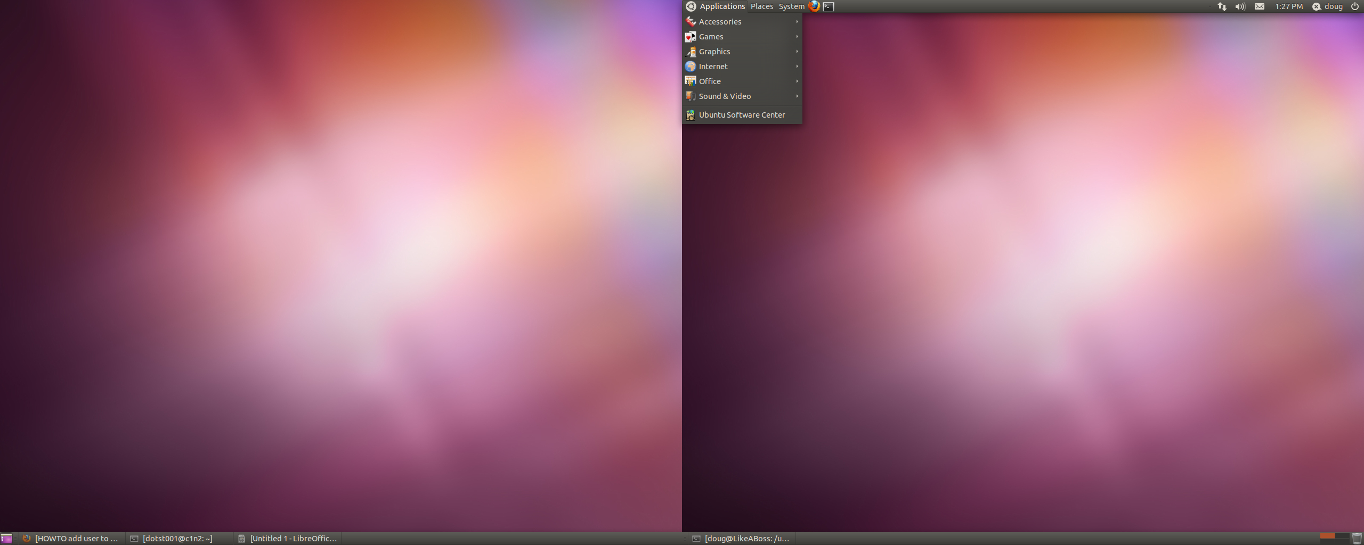
Arch Linux
Ubuntu 11.04 ”Natty Narwhal”

Slide 4
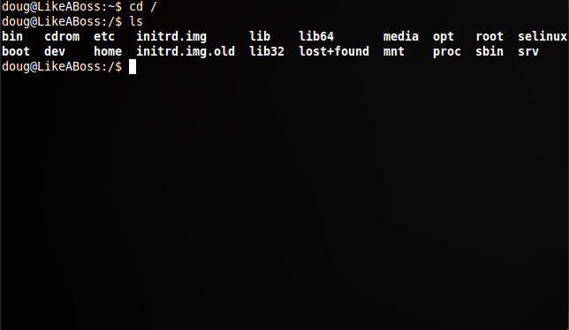
Arch Linux
Arch Linux After Installation

Slide 5
Arch Linux
What is Arch?
Arch Philosphy:
”There are many good forms of transportation. I think we'll crawl”
No automation and direct system file manipulation for all configuration.
Arch is ”lightweight and simple” because it ships with the minimal packages for the system to work.

Slide 6
Arch Linux
Installation Guide:
  https://wiki.archlinux.org/ (beginner's guide)
  Be advised
    You will have to edit several .config files
    You will need to manually select each package
      (take core)
    Partition is exceptionally frustrating
    Add yourself to wheel group/sudoers file
    Install sudo

Slide 7
Arch Linux
Pacman – Arch Package Manager
apt-get to pacman translator
  Install = -S
  Search = -Q
  Remove = -R
Flags (-R)
  -s = recursive (for completely uninstalling a package and all its dependencies)
  -c = also removes all a packages dependent on it

Slide 8
Arch Linux
Pacman (cont)
  Useful commands
    (pacman -S ubuntu) j/k
    Pacman -Syu = upgrade
    Pacman -Syy = refresh mirrorlist

Slide 9
Arch Linux
Adding A GUI

Slide 10
STOP!
Are you already excessively frustrated?
  Take a break
  Maybe Arch isn't for you
  Have a drink?
  Stop by the ACM (ECS Room 280) and ask for help

Slide 11
Arch Linux
Adding A GUI
Install X-Server
pacman -S xorg-server xorg-xinit xorg-utils xorg-server-utils
Install VideoCard and input drivers
pacman -S xf86-input-keyboard xf86-input-mouse
Install and start dbus
pacman -S dbus
rc.d start dbus
You will want to add it to /etc/rc.conf DAEMONS = {...}

Slide 12
Arch Linux
Adding A GIU
Select a Desktop Enviroment/Windows Manager
pacman -S kde kde-meta
Start KDE
There are several ways to do this:
  Edit /etc/initab
    x:5:respawn:/usr/bin/xdm -nodaemon
    x:5:respawn:/usr/bin/kdm -nodaemon
  Reboot

Slide 13
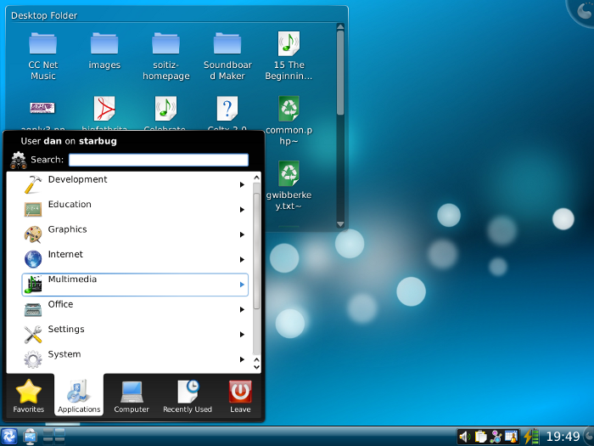
Arch Linux

Slide 14
Arch Linux
?
Questions

